Slide 1




Royal University of Phnom Penh
Faculty of Engineering
Major: Data Science and Engineering
EXPLAINABLE AI FOR DIABETES RISK PREDICTION AND ACTIONABLE INSIGHTS
Presenter: Nhor Povketya
Advisor: Dr. Khim Chamroeun

Slide 2
OUTLINE
  Background and Motivation
  Research Objective
  Literature Review
  Methodology
  Results
  Conclusion
  Demo

Slide 3


Introduction
BACKGROUND AND MOTIVATION
  Diabetes is a chronic disease associated with serious complications such as heart disease, kidney failure, and vision loss
  Early risk prediction can support prevention and screening
  Machine learning identifies risk patterns from health and lifestyle survey data
  Explainable AI helps users understand model predictions, reveals reasoning behind model predictions
01

Slide 4
Introduction
PROBLEM STATEMENT
01
Traditional diabetes screening may require time, cost, and medical resources
02
Existing prediction systems often focus only on prediction accuracy without explaining the results clearly
03
Cambodia has limited AI-based diabetes prediction research using local health data
04
Health datasets may contain missing values and imbalanced data, which can affect model performance
05
Need for explainable risk prediction system to raise awareness and support early screening
02

Slide 5
Introduction
RESEARCH OBJECTIVES
  Develop machine learning models for diabetes risk prediction using survey-based health indicators
  Train and validate the models using BRFSS 2017 data, and evaluate the final model on Cambodia STEPS as an independent test set
  Compare model performance using Recall, Precision, Accuracy, and F1-score
  Apply Explainable AI (SHAP) to identify key diabetes risk factors and explain individual predictions
  Generate actionable insights to support diabetes risk awareness and early screening
03

Slide 6




Introduction
RESEARCH QUESTIONS
RQ1
RQ2
RQ3
Can health survey data from Cambodia STEPS and BRFSS be used to predict diabetes risk without blood test data?
Which machine learning model is the best for finding people who may have diabetes risk?
Which health indicators contribute most to diabetes risk prediction according to SHAP analysis?
04

Slide 7
LITERATURE REVIEW
Paper / Author | Model Used | Dataset Type | Accuracy / Result
Xie et al. (2019) — Building Risk Prediction Models for Type 2 Diabetes Using Machine Learning Techniques | SVM, Decision Tree, Logistic Regression, Random Forest, Neural Network, Naive Bayes | BRFSS 2014 survey data | Neural Network: 82.4% accuracy, AUC 0.7949. Decision Tree had highest sensitivity 51.6%
Khokhar et al. — Towards Transparent and Accurate Diabetes Prediction Using ML and XAI | Random Forest, XGBoost, LightGBM, Ensemble Model + SHAP/LIME | Diabetes Binary Health Indicators dataset from BRFSS 2015 | Ensemble model: 92.50% accuracy, ROC-AUC 0.975. Important features: BMI, Age, General Health, Income, Physical Activity
Katiyar et al. (2024) Recent Advancements Using ML & DL Approaches for Diabetes Detection | ML and Deep Learning Models | Multiple Diabetes Datasets | ML and DL models achieved high prediction performance, dataset quality significantly affects results
Li et al. (2025) Performance of Diabetes Risk Prediction Models | Statistical Models + Machine Learning Models | Population Health Datasets | Risk prediction models can support early screening and prevention of Type 2 Diabetes
Khokhar et al. (2025) Advances in Artificial Intelligence for Diabetes Prediction | Logistic Regression, SVM, Random Forest, XGBoost, CNN, RNN | Multiple Public Diabetes Datasets | Reviewed 53 studies, highlighted strong performance of ML models and the need for explainable and clinically relevant systems
05

Slide 8
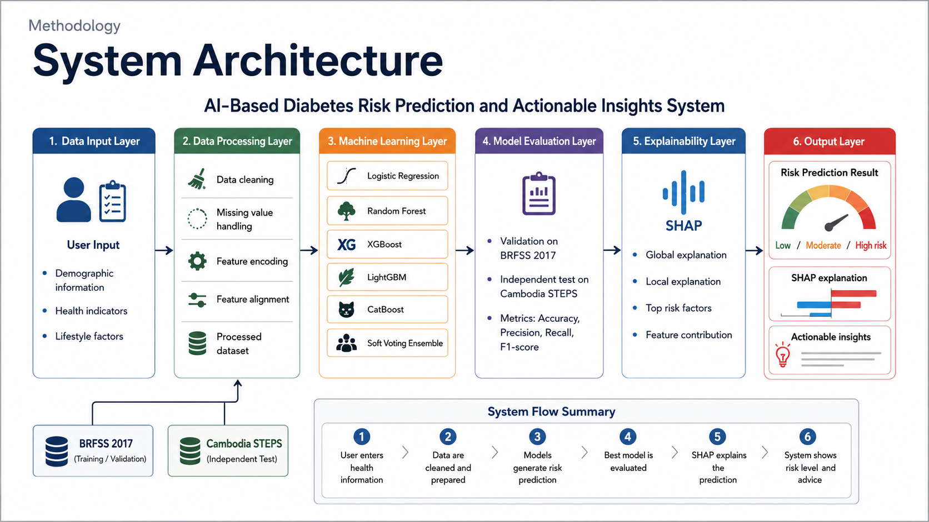

Methodology
System Architecture
06

Slide 9
Methodology
DATASET OVERVIEW
Cambodia STEPS
BRFSS
Local survey data collected in Cambodia
  Demographic indicators (age, sex, education)
  Health indicators (BMI, blood pressure, cholesterol)
  Lifestyle indicators (smoking, physical activity, diet)
  873 rows after preprocessing with 14% of Positive rate
  Target: Diabetes status (0 = non-diabetes, 1 = diabetes)
Larger benchmark dataset from the United States
  Similar health and lifestyle indicators
  Used for training 2017
  275746 rows after preprocessing 16% of Positive rate
  Target: Diabetes status (0 = non-diabetes, 1 = diabetes)
07

Slide 10



Methodology
SELECTED FEATURES
Demographic
Health Status
Lifestyle & Healthcare Access
Age
Sex
Education
High Blood Pressure
High Cholesterol
BMI
Smoker
Physical Activity
Fruits
Vegetables
Heavy Alcohol Consumption
08

Slide 11
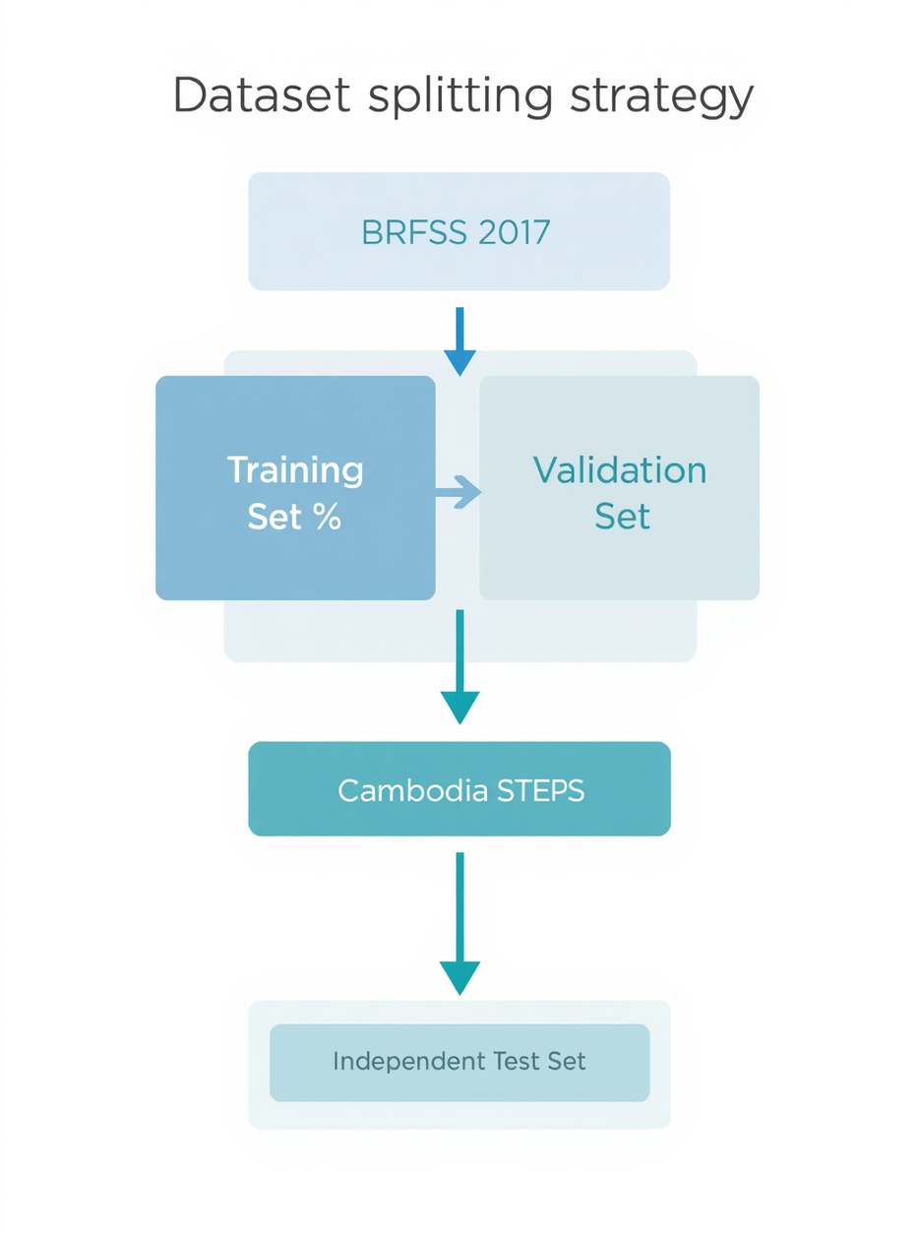
Methodology
DATA SPLITTING STRATEGY
BRFSS 2017 Dataset
  80% Training Set: Used for model learning and fitting
  20% Validation Set: Used for model selection and decision threshold tuning
Cambodia STEPS Dataset
  Independent Test Set: Used for final cross-population evaluation only
09

Slide 12


Methodology
MACHINE LEARNING MODELS
  Logistic Regression
  Random Forest
  XGBoost
  LightGBM
  CatBoost
  Soft Voting Ensemble
10

Slide 13
Methodology
EVALUATION METRICS
Recall
Precision
Accuracy
F1 Score
11

Slide 14
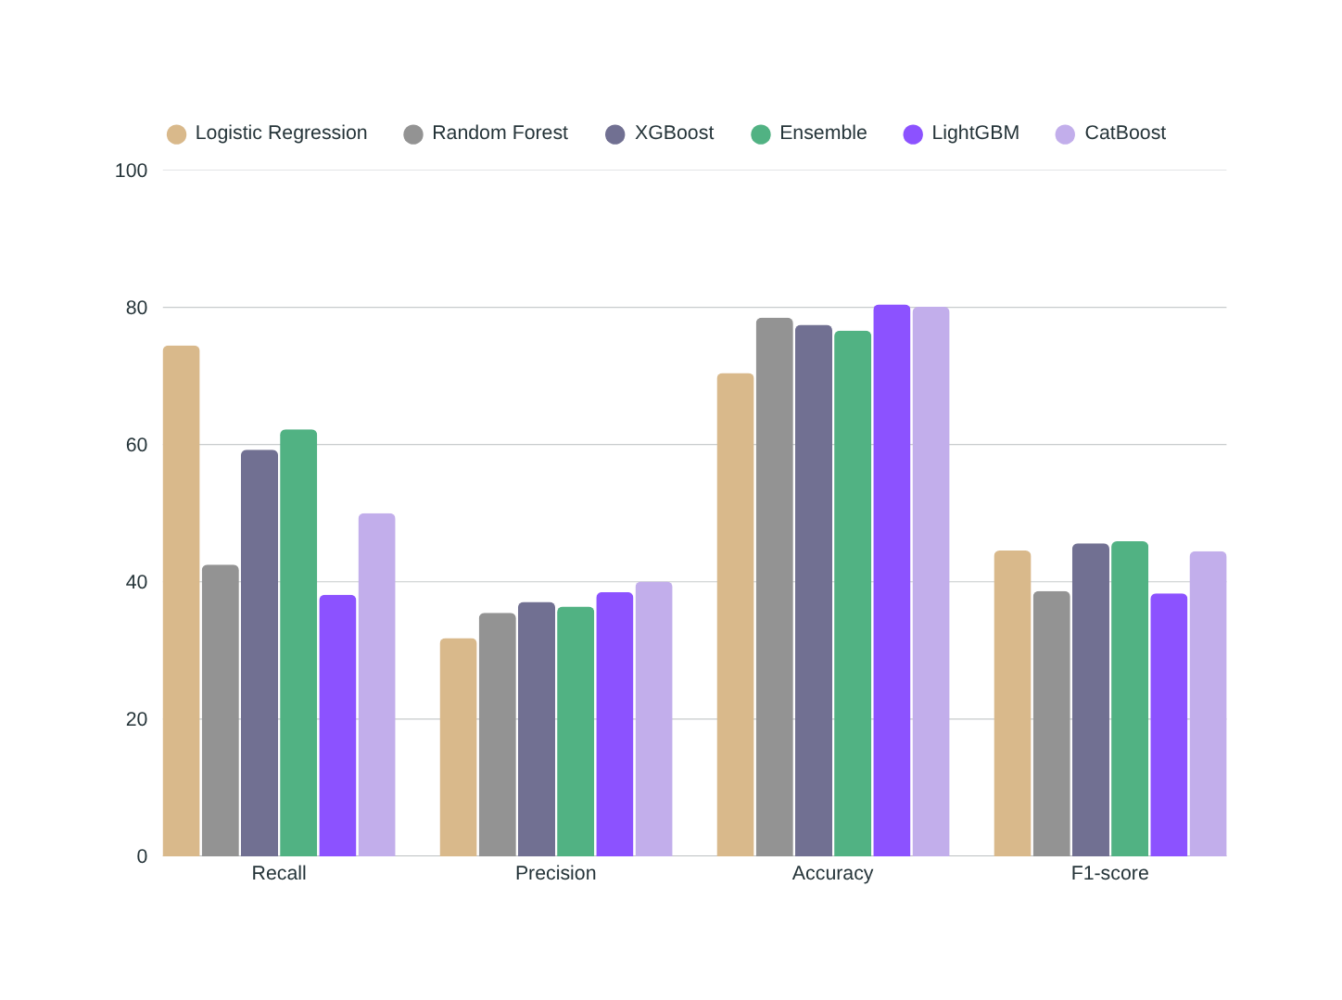
Results
Model Evaluation and Results
12

Slide 15
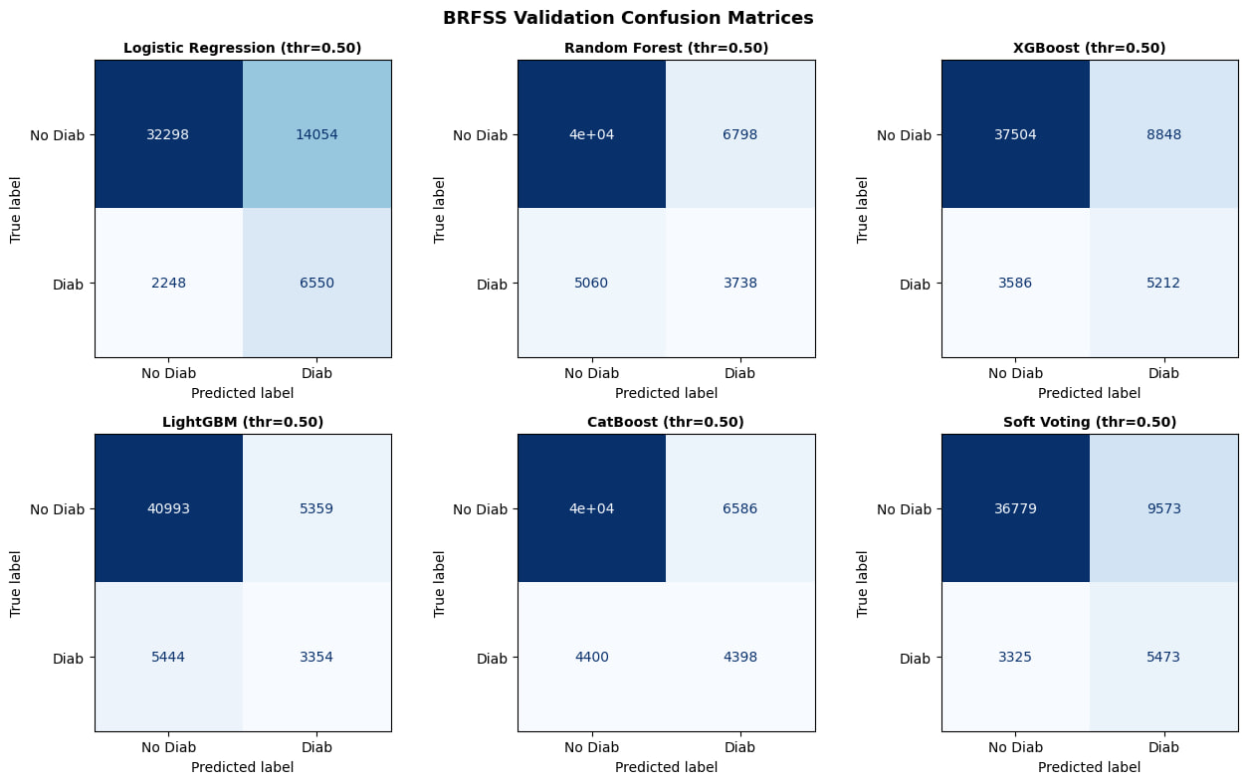
Results
Confusion Metrices
13

Slide 16
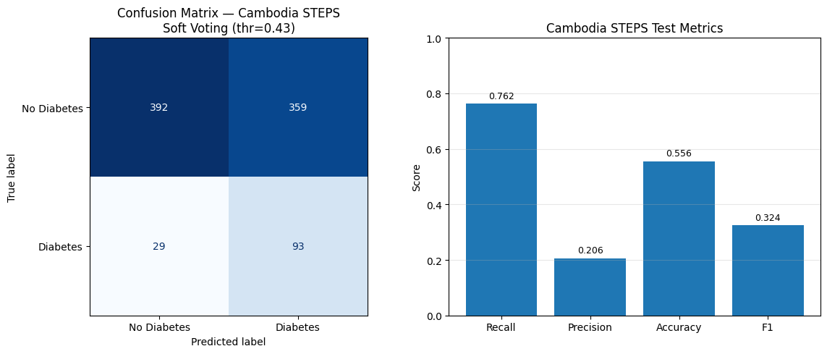
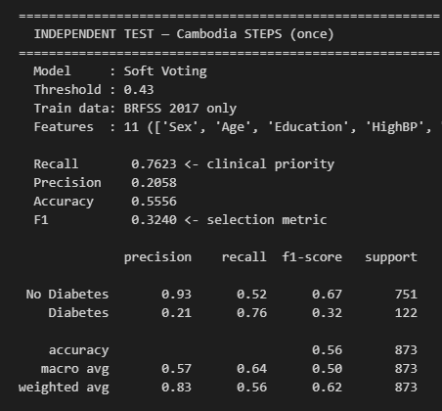

Results
CAMBODIA STEPS INDEPENDENT TEST RESULT
  Final selected model: Soft Voting Ensemble
  Lower performance is expected because the datasets come from different populations and survey systems
14

Slide 17
Results
EXPLAINABLE AI
Global Explanation
Local Explanation
Overall feature importance across the entire dataset using SHAP summary plots.
• Identifies which features most influence diabetes risk predictions globally
• BMI, age, blood pressure, and general health rank as top contributors
• SHAP summary plot visualizes direction and magnitude of each feature's impact
• Enables model-level transparency for researchers and practitioners
Individual prediction rationale for a single patient using SHAP force plots.
• Explains why the model assigned a specific risk probability to one person
• Shows which features pushed the prediction higher or lower
• SHAP force plot highlights positive and negative contributing factors
• Builds trust by making individual predictions interpretable and actionable
15

Slide 18
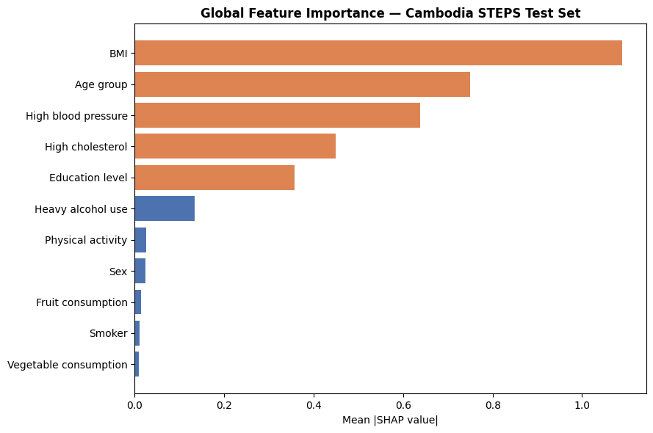
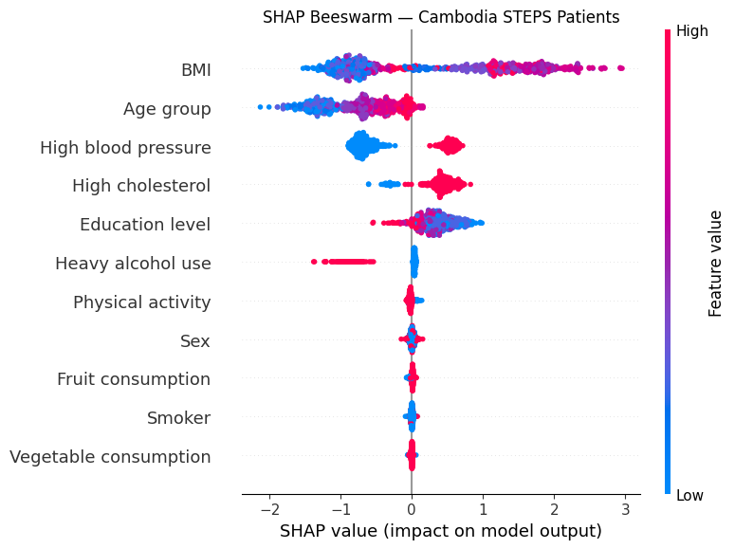
Results
SHAP ANALYSIS
SHAP was used to explain how the final Soft Voting Ensemble model makes diabetes risk predictions
16

Slide 19
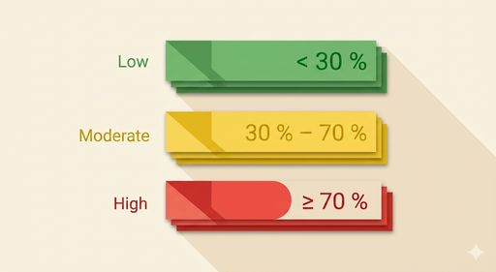
Results
RISK OUTPUT & ACTIONABLE INSIGHTS
Risk Levels
Actionable Insights
🟢 Low Risk
Probability < 30%
Continue healthy habits and routine check-ups
🟡 Moderate Risk
Probability 30% – 69%
Consult a healthcare provider and monitor key indicators
🔴 High Risk
Probability ≥ 70%
Seek medical advice promptly and take preventive action
Actionable Insights:
  Check blood sugar with a healthcare provider
  Maintain a healthy BMI
  Increase physical activity
  Improve diet by reducing sugar and eating more vegetables and fruits
  Monitor blood pressure and cholesterol regularly
17

Slide 20
Limitation and Future Work
Limitation:
Cambodia STEPS dataset is small: 873 records
  Data is imbalanced, with only about 14% diabetes cases
  BRFSS and STEPS are from different populations
  No clinical blood test data such as glucose or HbA1c
Future Work:
Collect more Cambodia health data
  Add clinical features such as glucose and HbA1c
  Improve model performance on local data
18

Slide 21
CONCLUSION
Built an explainable AI system for diabetes risk prediction
Trained models using BRFSS 2017 data
Tested the final model on Cambodia STEPS
Selected Soft Voting Ensemble as the final model
Used SHAP to explain important risk factors
Generated risk level and actionable recommendations
19

Slide 22
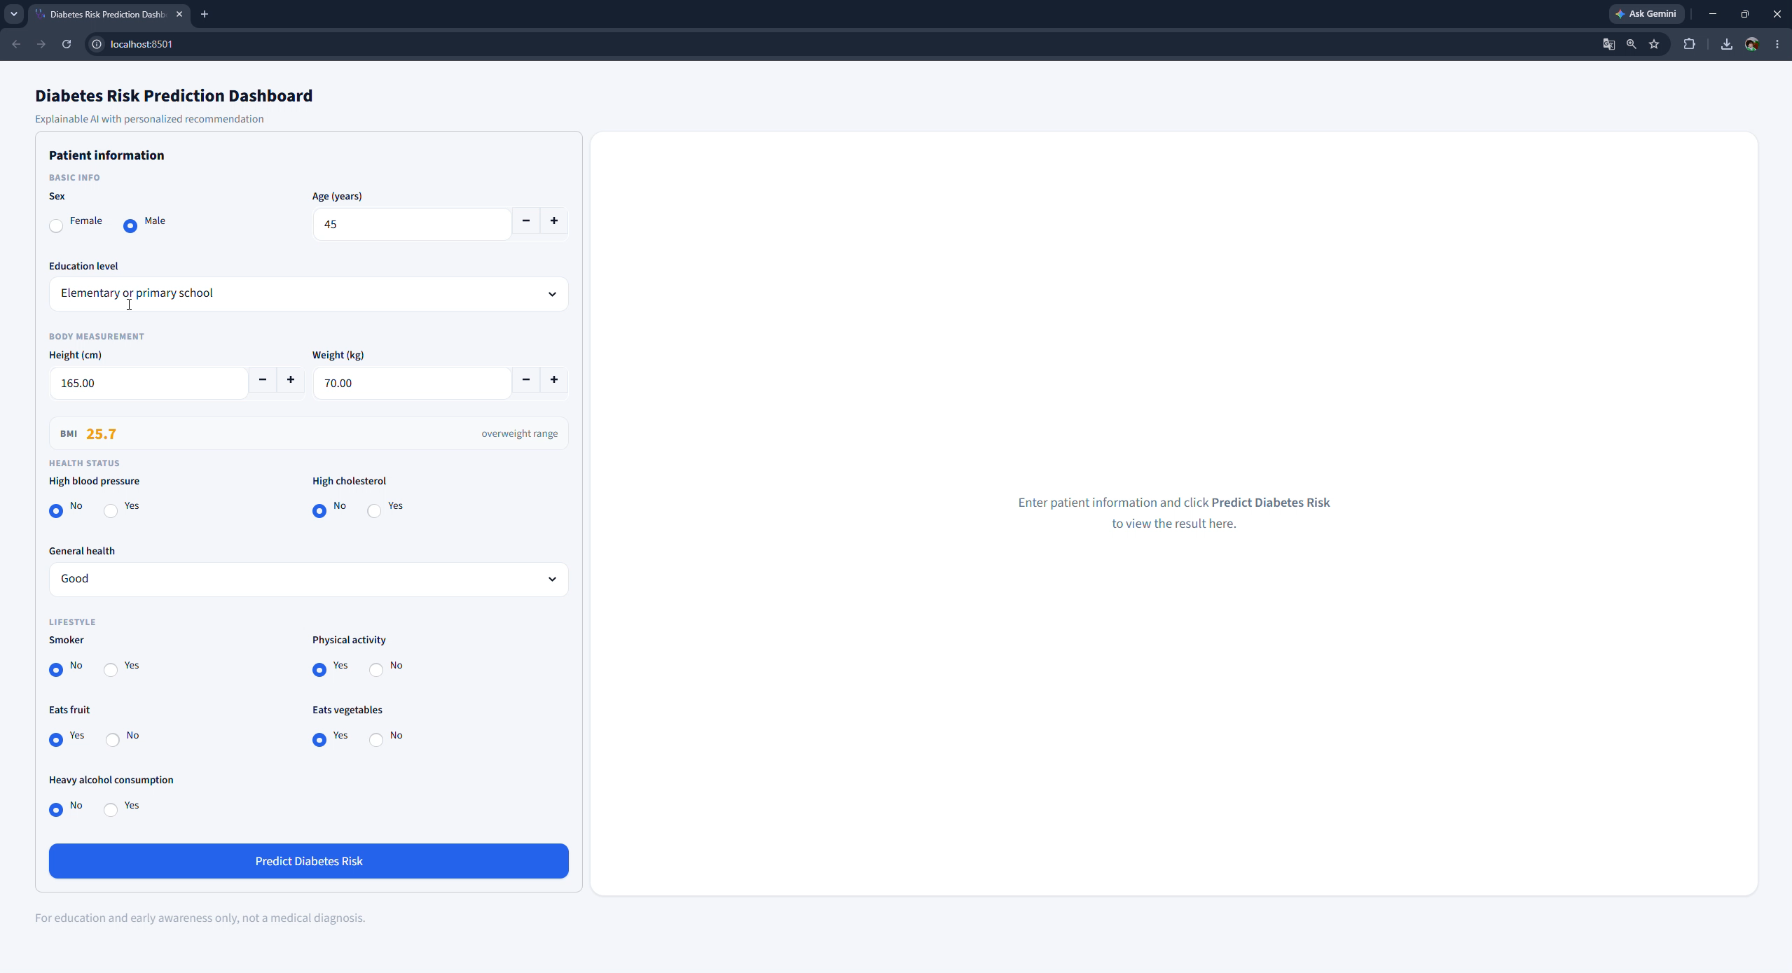
Demo

Slide 23
Thank You

